Slide 1


HUGGING FACE
Llama-2-7b-chat-hf
Presented by:
Isariya Triampetch (21224535)
Pichaya Detchwongchaikul (21224052)

Slide 2
INTRODUCTION
What is Hugging Face and Why is it important ?
According to Maning (2021), “Hugging Face is an open-source platform that provides tools and resources for working on natural language processing (NLP) and computer vision projects.”
Hugging Face is especially important because it provides the tools to involve as many people as possible in shaping the artificially intelligent tools of the future1. It has become a leading platform for learning and sharing ideas about machine learning.
How can pretrained models accelerate data science and AI research?
By providing several key benefits that streamline the development process and enhance the capability of AI solutions such as reduced development time, Improved accuracy, and increased accessibility.

Slide 3
INTRODUCTION
How can pretrained models accelerate data science and AI research?
By providing several key benefits that streamline the development process and enhance the capability of AI solutions such as reduced development time, Improved accuracy, and increased accessibility.
Pretrained models save data scientists and artificial intelligence developers a great deal of time and effort by removing the requirement to train models from scratch (Fu, 2022).
According to this, researchers can swiftly fine-tune a pretrained model for their specific tasks, which leads them to focus on more complex and innovative aspects of their projects, such as feature engineering and model evaluation.

Slide 4

PROBLEM AND MOTIVATION
What problem are you addressing with Hugging Face pretrained models?
Hugging Face pretrained models are an effective means of utilizing the most recent advancements in natural language processing (NLP) technology while customizing the model for particular applications or domains.
References
Why is this problem important to data science and AI?
Difficulty of training NLP models
Lack of labeled data
Lack of expertise
Lack of computational resources
According to Han et al. (2021) article said that through the process of fine-tuning, artificial intelligence practitioners can develop highly performant models with limited task-specific data by leveraging the massive knowledge gained from large-scale data.

Slide 5


DATA AND PREPROCESSING
What dataset did you use for your project?
How did you prepare the data for analysis?
Dataset
Preparation
First Dataset: Use IMDB movie review csv file. Use the AI to analyze the comment rather the review is Positive or Negative.
Second Dataset: Use YouTube API and video ID, to let the AI that our group train analyse the comments.
1) Find the dataset for analyze
2) Import the AI from Hugging Face to the program
3) Import the dataset to the program and run it
P.S. For the IMDB movie review file. It need to compress to a small size due to the spec of our PC are not capable for run all of the data
4) Run all the code

Slide 6

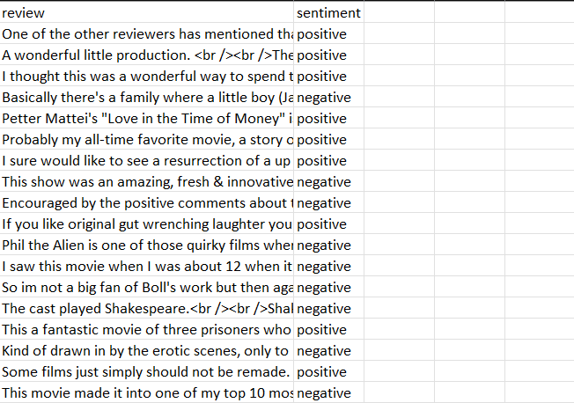
DATASET (CSV)

Slide 7
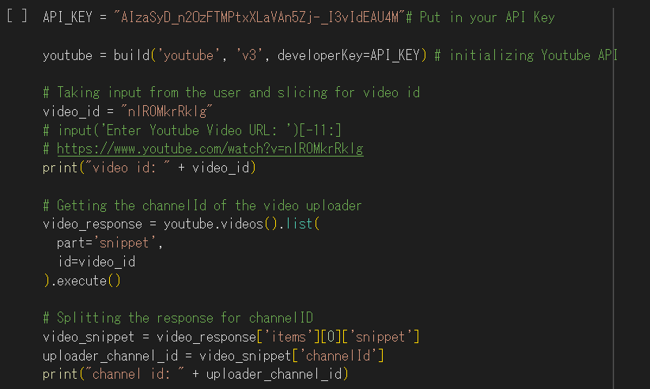
YOUTUBE API

Slide 8

MODEL SELECTION AND TRAINING
Why did you choose the specific Hugging Face pretrained model you used?
Llama 2 is a collection of pretrained and fine-tuned generative text models ranging in scale from 7 billion to 70 billion parameters.
Meta developed and publicly released the Llama 2 family of large language models (LLMs), a collection of pretrained and fine-tuned generative text models ranging in scale from 7 billion to 70 billion parameters.

Slide 9
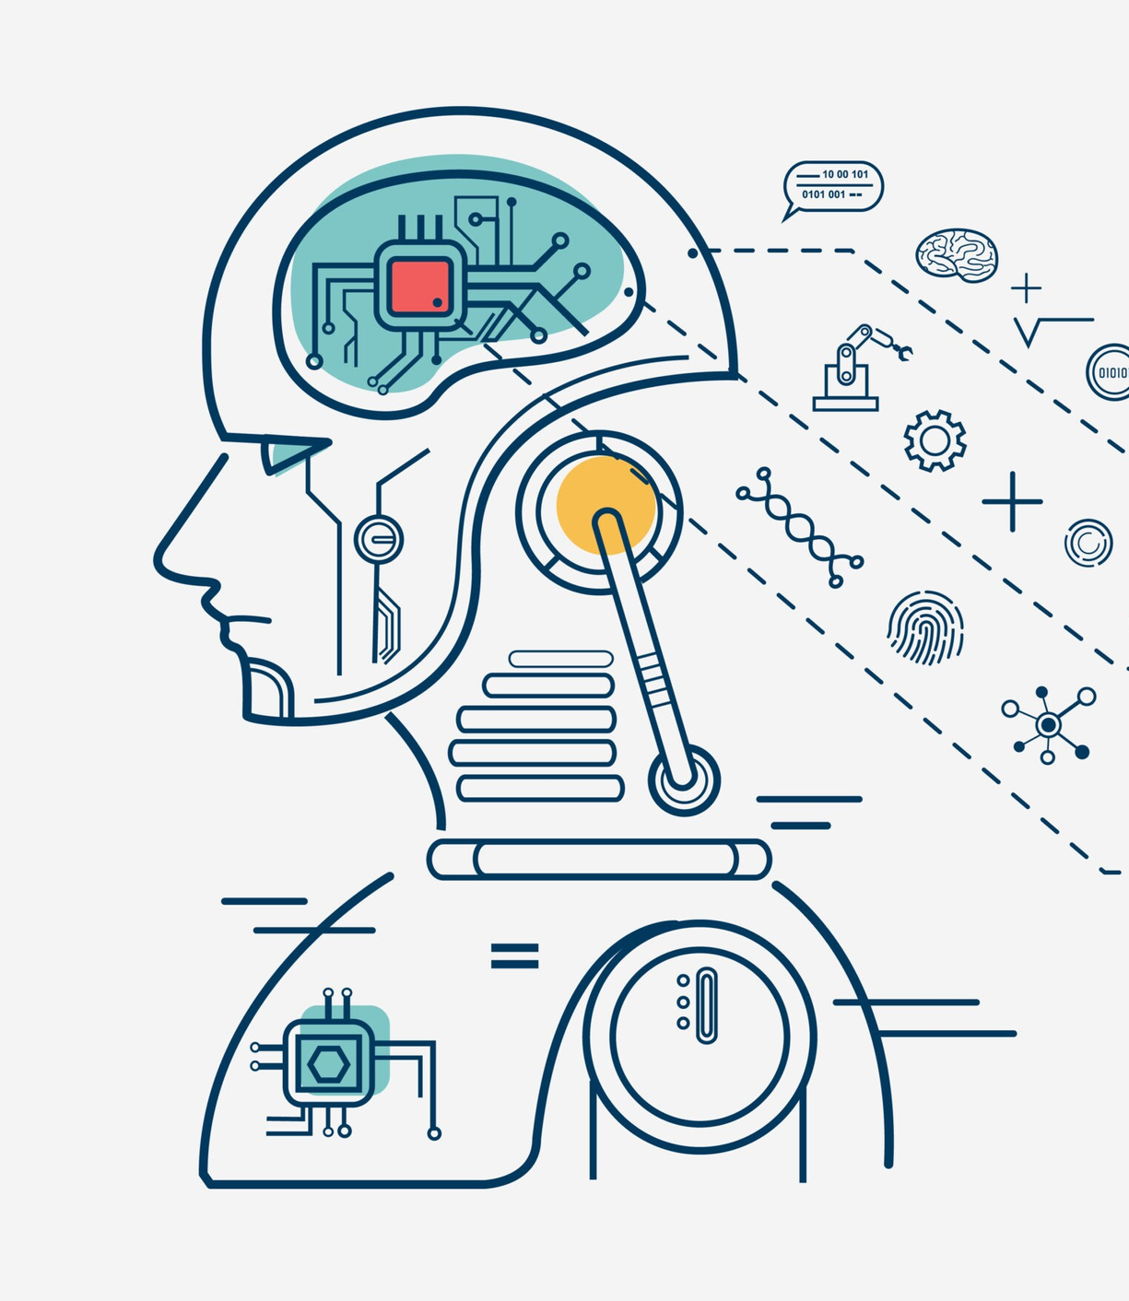
MODEL SELECTION AND TRAINING
How did you train the model and evaluate its performance?
Train this model by using KNN (K-Nearest Neighbor) and the SVM (Support Vector Machine) to check the accuracy of the code; rather the code analyze the comments accurately or not

Slide 10
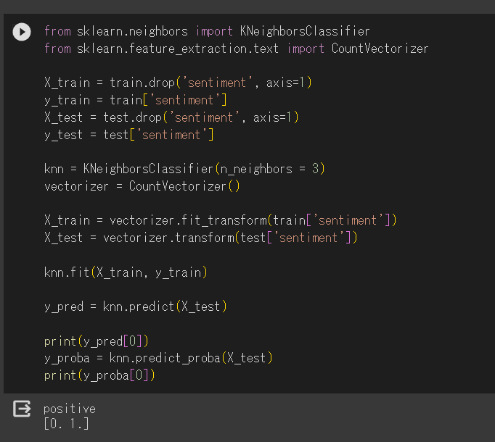
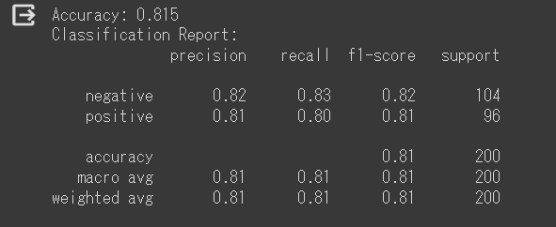
KNN AND SVM TRAIN BY USING LLAMA-2
CSV File

Slide 11
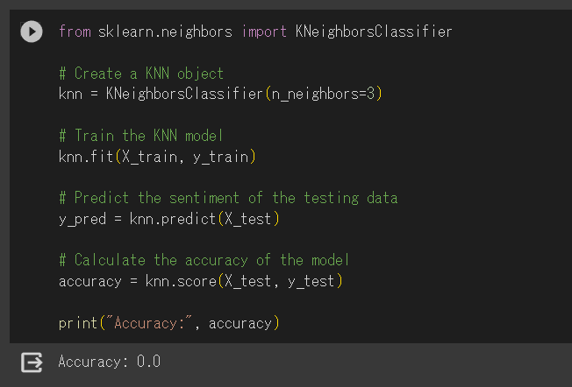
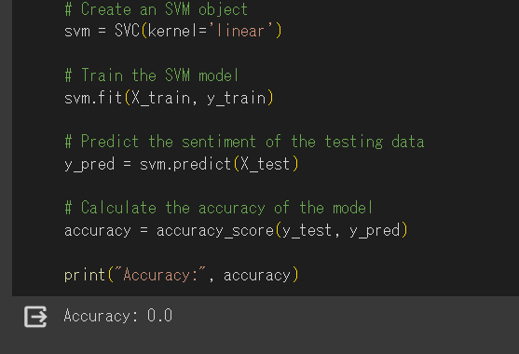
KNN AND SVM TRAIN BY USING LLAMA-2
API Key

Slide 12

RESULTS AND DISCUSSION
What did you learn from your analysis?
Know how to use machine learning with the dataset and API key.
Using Dataset will got more accurate result than using API key.
What are the implications of your findings?
Can be use to analyse the review or comment on Social Media such as Facebook, Instagram, etc.
Recommend with dataset more than API key (Base on our group outcome)
It can be develop to use with those webpage that allow people to share their opinion to detect hate speech.

Slide 13
CONCLUSION AND FUTURE WORK
What are the main takeaways from your research?
Using the dataset will get an accurate result than API key.
What are some potential future directions for research using Hugging Face pretrained models?
Improving the robustness and generalization of pretrained models to different domains, languages, and tasks.
Enhancing the creativity and expressiveness of pretrained models for generating novel and engaging content.

Slide 14
REFERENCES
Hugging Face. (n.d.). Hugging Face. Retrieved November 28, 2023, from https://huggingface.co/
Maning, J. (2023, September 22). What Is Hugging Face and What Is It Used For?. Retrieved from https://www.makeuseof.com/what-is-hugging-face-and-what-is-it-used-for/
Fu, Z., Yang, H., So, A. M.-C., Lam, W., Bing, L., & Collier, N. (2022). On the Effectiveness of Parameter-Efficient Fine-Tuning. Retrieved from https://arxiv.org/abs/2211.15583
Han, X., Zhang, Z., Ding, N., Gu, Y., Liu, X., Huo, Y., Qiu, J., Yao, Y., Zhang, A., Zhang, L., Han, W., Huang, M., Jin, Q., Lan, Y., Liu, Y., Liu, Z., Lu, Z., Qiu, X., Song, R., Tang, J., Wen, J.-R., Yuan, J., Zhao, W. X., & Zhu, J. (2021). Pre-Trained Models: Past, Present and Future. https://arxiv.org/abs/2106.07139
Li, Y., Zhang, Y., & Radev, D. (2021). Improving robustness and generalization of pretrained models for natural language generation. In Proceedings of the 2021 Conference of the North American Chapter of the Association for Computational Linguistics: Human Language Technologies (pp. 3879-3890)1
Gatt, A., & Krahmer, E. (2018). Creative and expressive natural language generation. In The Oxford Handbook of Computational Linguistics (2nd ed.). Oxford University Press4.

